Slide 1

new year, refreshed merchandising strategy
Let’s discuss merchandising trends that will shape 2023

Slide 2

New Year, New Platform
Library - we will now have a living library of all Best Practices Sessions that you can view at any time for free
1
Dual time-zone - we will now have two versions of every Best Practices session for US vs. EMEA beginning in March
2

Slide 3

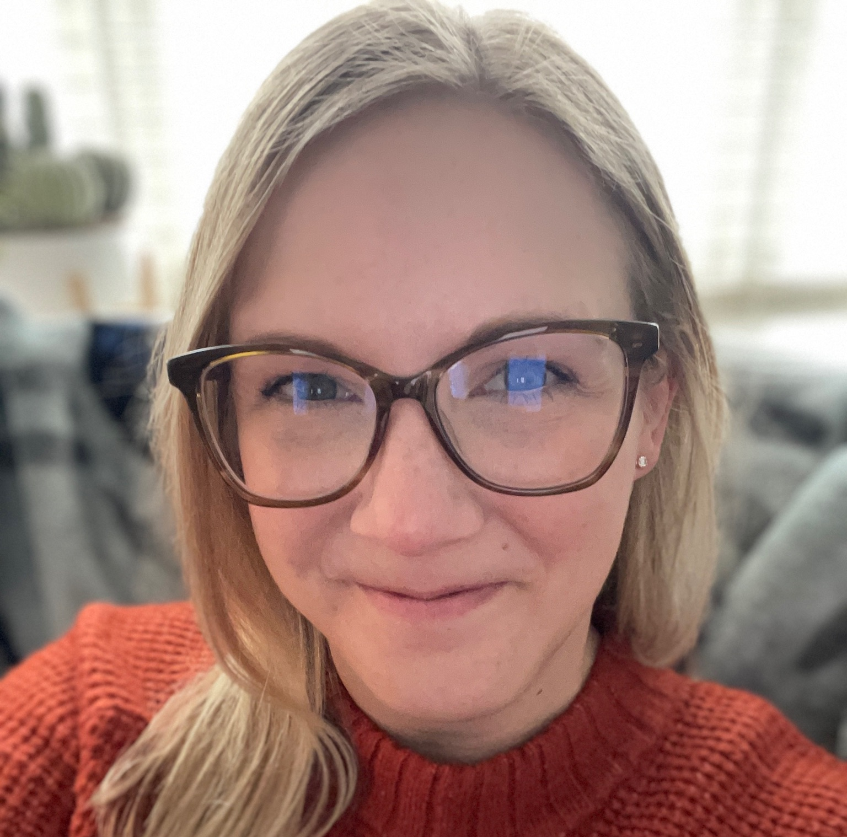

Your Bloomreach Hosts
Kyle Wilson
Brittni Ayers
Jenna Ghidaleson
Lead Experience Strategist
Senior Manager, Experience Strategy
Digital Experience Manager
kyle.wilson@bloomreach.com
brittni.ayers@bloomreach.com
jenna.ghidaleson@bloomreach.com
Notes:
Give formal intro of yourself
Hi. My name is Brittni Ayers. I’m on the experience strategy team here at Bloomreach and have been with the company for just over a year. Prior to my time here, I spent over a decade at Whirlpool corporation in roles spanning my most recent as merchandiser for small appliances on kitchenaid.com to various roles within supply chain ranging from support of production and inventory planning all the way to delivery to the end consumer.

Slide 4
Merchandising trends that will shape 2023

Slide 5
State of the Industry
Economic uncertainty
Global inflation reached 6.5% in 2022, twice the average of 2.9% recorded during 2010–2020.
1
Finding the Balance
Supply chains are in surplus due to diminished purchasing power and a shift in consumer behavior favoring experiences
2
Inventory Surplus
Notes:
Jenna
Recession:
Inflation reached a high of 6.5% in 2022
Acquisitions cost may be scrutinized by leadership
Inventory surplus:
There’s still backup at the port
61%
Retailers pulled up promotional strategies earlier in Q4 to drive sell through…
Jenna notes: two trends continue to persist in the overall retail sector -- supply chains issues due to covid 19 & global inflation rates reaching 6.5% and slowly rising by the day ... seeing that a lot of retailers are heavy in inventory within categories that were impacted by covid19, while also ensuring pricing is reflectant of the current climate, it’s important that we find a balance between the two.. We need to drive margin and sell thru inventory while at the same time trying keep in mind the economic uncertainty in today’s world. [next slide]

Slide 6
with this in mind, how do you win this year and beyond?
Notes:
JENNA

Slide 7
MERCHANDISING 2023 TREND REPORT
focus on margins.
Notes:
BRITTNI
Focus on margin.

Slide 8
Optimize for margin.
1
2
3
4
5
6
Enhanced Value Proposition.
Start Small.
Upsell to higher margin products.
Build your basket.
Optimize omni-channel profitability.
Streamline the experience to minimize returns.
Notes:
How can we accomplish this?
First, enhance your value proposition. Why should customers buy from you?
This goes above and beyond price. Start with what entices your customers to covert - think convenience in omni-channel, free returns. But, go above and beyond this. What are the extras? What makes you unique or stand out? How can you lean into this more heavily? Once you know what makes your company unique and keeps your customers with you, then make sure they’re clear and visible to your customers on your website and in the ways you communicate with them.
Second, start small.
If your customers are conditioned to wait for a sale, you aren’t going to change those behavior’s overnight. So, consider pulling ahead demand from significantly discounted time periods like Q4 holiday sales for example if you’re in retail, and look to sell more sooner and if possible, at a higher price. Depending on the surge in demand you anticipate and how it impacts your supply chain, you can still increase profits by pulling ahead demand at the same discounted prices because you may be saving in warehouse storage or overtime by balancing out fulfillment. In Q4 last year, I saw target price matching themselves throughout the season - I think this is a great way to try to achieve this and also build your value proposition up during a key selling period.
Third, upsell to higher margin products.
The goal here is to develop a strategy to increase sales for products where your margins are already higher. This could be shifting to alternative products, perhaps categories or specific products where margins are higher or maybe you have in-house or private label brands where margin is higher. I’ll talk more about this shortly.
Fourth, Build your basket.
In addition to selling higher margin products, look for ways to cross-sell and build your basket size, either increasing average order value or units per order. The idea here is to inspire consumers and make it easier for them to build their basket throughout the entire journey. Great purchasable content can also help you achieve this.
Fifth, optimize omni-channel profitability
It’s important to understand the costs associated with various service methods: pick up in store vs. shipping vs. drive up for example. Which one requires more resources/cost? Can you work toward understanding the consumer’s preferences and alleviate costs by serving them based on their unique needs? Is there an opportunity to build basket size more easily with certain methods vs. others? Is there an appetite with your consumers to pay for convenience and alleviate some operational expenses associated? The solution is not one size fits all.
Finally, streamline the experience to minimize returns. Size charts, accurate product descriptions and ux clarity, alongside clear and accurate assets on the PDP can help you drive clarity with customers on what they are purchasing and how it might fit their needs prior to their purchase, helping to alleviate their need to return product later on.

Slide 9
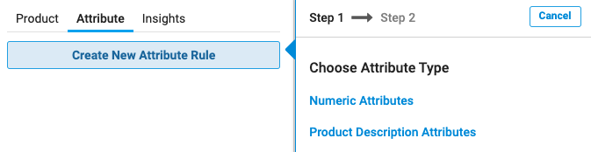
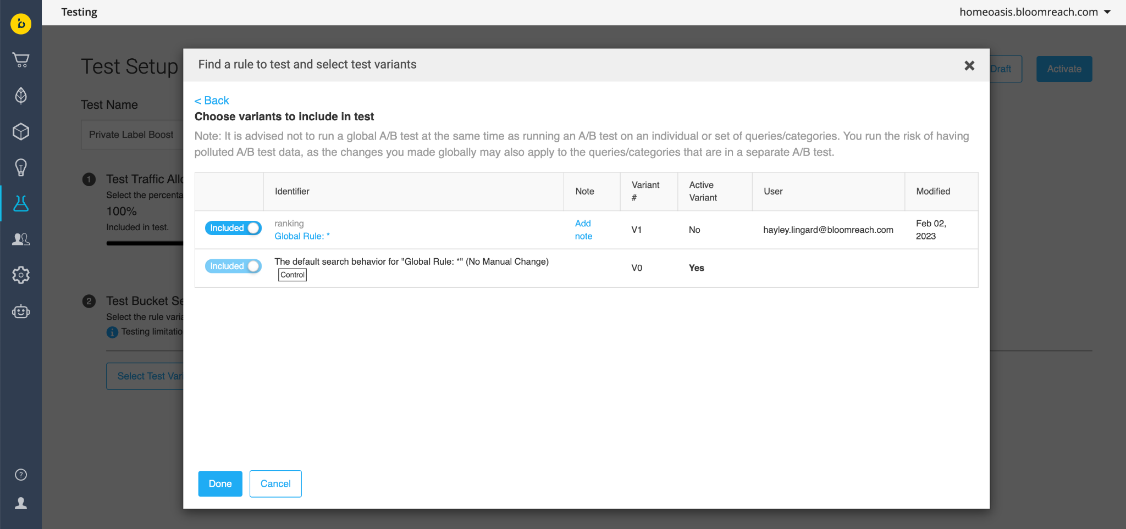
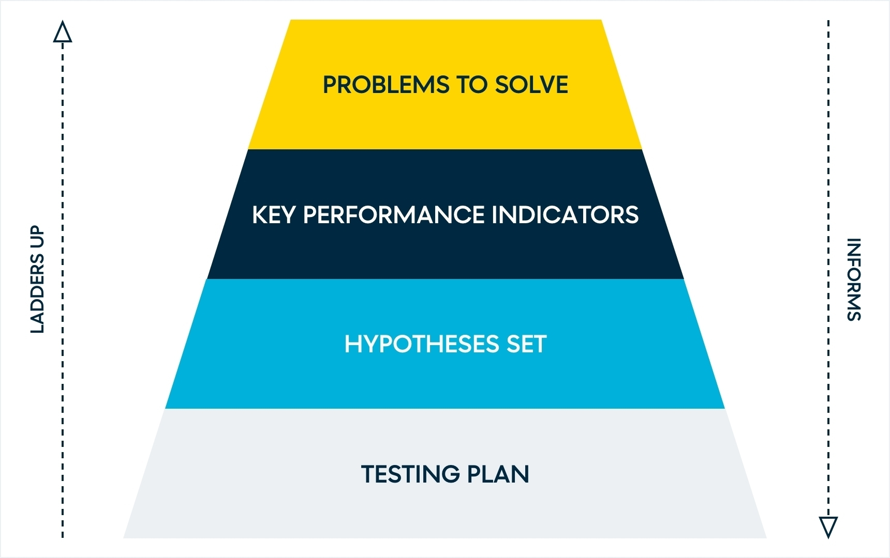

Margin
Upsell to higher margin products
Example Use Case
1. Create Attribute & Ranking Rule
Hypothesis
‘Increasing visibility of owned or house brands that drive greater margin will increase conversions for these products and deliver improved margin for the business’
2. Test the hypothesis. Learn. Iterate.
ATTRIBUTE BOOST RANKING RULE
Solutioning
DO WITH:
A/B TESTING
Notes:
Let’s dive in a little deeper into upselling to higher margin products. The hypothesis here is ‘increasing visibility of owned or house brands that drive greater margin will increase conversions for these products and deliver improved margin for the business’ There are several ways to tackle this. You can:
Manually structure the product grid and determine exact placement of products within it
However, a more scalable way would be to utilize an attribute and boost to influence the algorithm to accomplish this:
A numeric attribute which passes margin could be utilized, a yes/no attribute where margin exceeds a certain threshold could be created, or you could even utilize a product description attribute for brands, or even a specific category if you have specific categories of products which have higher margins. How you design this attribute depends on your business, but once it’s defined and passed into Bloomreach, it is easy to set it up.
I highly recommend building a testing plan in this case and then once the details of that plan are defined, utilizing Bloomreach a/b testing in order to run tests. Testing can be accomplished at a global level, a global search and/or global category level, or can be restricted to specific queries or categories with which the test is ran. Depending on your goals and planning strategy, how you tackle this can vary. However, testing allows you to prove or disprove your hypothesis, gain learnings and build subsequent tests to further optimize.

Slide 10
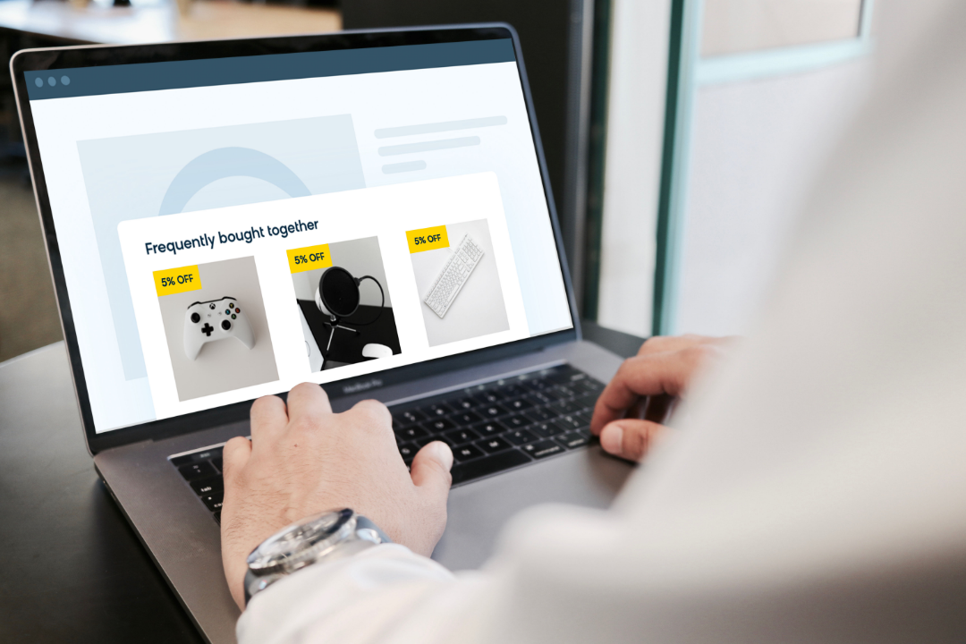
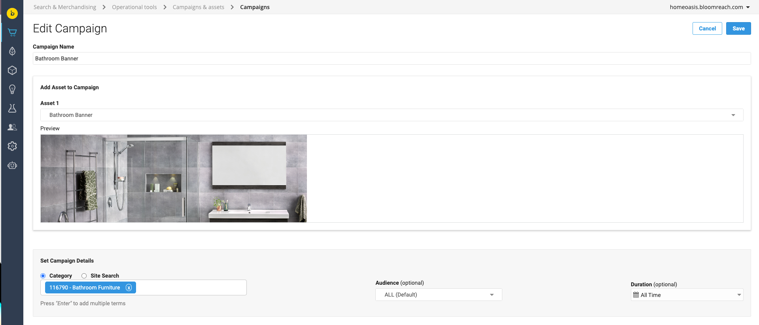
Margin
Build your basket.
Example Use Case
Hypothesis
‘Improving discoverability of upsell and cross-sell opportunities throughout the funnel will increase Average Order Value (AOV)’
RECOMMENDATIONS & PATHWAYS
Solutioning
DO WITH:
CAMPAIGNS & ASSETS
Notes:
Now let’s dive into building your basket. The example hypothesis here is ‘improving discoverability of upsell and cross-sell opportunities throughout the funnel will increase average order value.’ With Bloomreach, you can utilize campaigns and assets to build your basket by showcasing shoppable cross-sell focused content within search or category landing page. You can also tackle this using Recommendations & Pathways. Frequently bought together and frequently viewed together widgets can help you cross-sell while similar products could be an opportunity to either upsell or cross-sell. Pathways is another avenue if you have specific use cases here. Then, consider layering on the attribute we talked about earlier to ensure higher-margin products are being displayed within the widget where it matters most on your site in order to further focus on margin.

Slide 11
BR Data: Knowing where to look.
Find Data Here | The Report | The Insights | Perceived Problem | Action to Take
Insights > Opportunities > Improve Category Navigation Category: Bathroom Furniture | High Next Search Traffic Category Pages (beta) | 40% Next Search Traffic Rate with 80% of Site Searches Directly From This Category related to bathroom mirrors | Customers are expecting to find mirrors on this page, but they’re not. | Utilize Campaign & Asset on Bathroom Furniture page to showcase shoppable content that enables cross-sell to mirrors. Ensure you’re focusing on your highest margin mirrors.
Insights > Playbooks > Find Optimizations Bathroom Furniture related queries & categories | Associated Categories, queries or products with this Category/query | Bed & Bath category, accessories, shelves & mirrors and various vanity products are highly associated with this category. | Customers are expecting to easily shop for these products and categories throughout their journey on these pages. Make it easier to navigate between them. | Leverage Pathways to cross-sell high margin bed & bath, accessories, shelves & mirrors products on the Bathroom Furniture category. Consider a widget in checkout to showcase associated high-margin, lower priced accessories. Consider similar products widget on PDP and leveraging a margin numeric attribute sort.
Tip: Test into your merchandising strategy.
Notes:
Finding the balance between offering basket builds customers are seeking and driving your P&L is a delicate initiative. There’s no better way to tackle this than utilizing the data you have at your fingertips within Bloomreach Insights to figure out what to showcase and what matters to your customers.
Let’s talk about this top practice example that I made up. Here, I’m looking to figure out what I should showcase as it relates to the Bathroom Furniture category. Within insights, opportunities, improve category navigation, I can dig into the High Next Search Traffic Category Pages (beta) report. Here, I find out there is a next search traffic rate of 40%. We can then use insights to drill down even deeper to look at Site Searches directly from this category and by analyzing the patterns of those terms, we find out that 80% of them are related to bathroom mirrors. From this, we can infer that customers are expecting to find mirrors on this category page, but since we know our business and catalog, we know they’re not currently part of that page as mirrors are assigned to another category on our site. In this case, we can both meet the customer’s needs while tackling our margin goals by leveraging campaigns & assets on the bathroom furniture page to showcase shoppable content that enables cross-sell to mirrors. And when we select our content, we can make sure we’re choosing content that showcases mirrors that are of higher margin to further our business objectives, too.
In the next practice example I made up, I am again looking to find out what I should showcase as it relates to bathroom furniture. Within insights, playbooks, find optimizations, I can either look at a specific category or related-queries and then dig into associated categories, queries or products within this category or query report. Within these reports, I find that the bed & bath category, accessories, shelves & mirrors and various vanity products are highly associated with this category. Recall that a high association score means the strength of the relationship between two entities is high. The first product is always assigned 100 so if after that, it goes down to 0 fairly slowly in scale, for example, 98, 95, 90 instead of 40, 35, 15m then you can conclude the association is high between the entities. From this information, we can infer that customers are expecting to easily shop for these products and categories throughout their journey on these pages and we need to make it easier to navigate between them. Now that we’ve identified what the customer is seeking, we have several options on how we can go about meeting their needs:
We could leverage pathways to cross-sell high margin bed & bath, shelves, mirrors and accessories on the bathroom furniture category
We could consider a checkout widget to showcase associated high-margin, lower priced accessories, which I’d equate to what you see in a grocery store or gas station where gum and candy bars are near the checkout…more impulse purchase or lower-priced items.
Finally, we could consider a similar products widget on the PDP and even leverage a margin numeric attribute sort
There are a lot of ways to solve for the customer’s intent here so it’s important to leverage the data you have and test into the strategy that meets your customer’s needs and your business objectives.

Slide 12
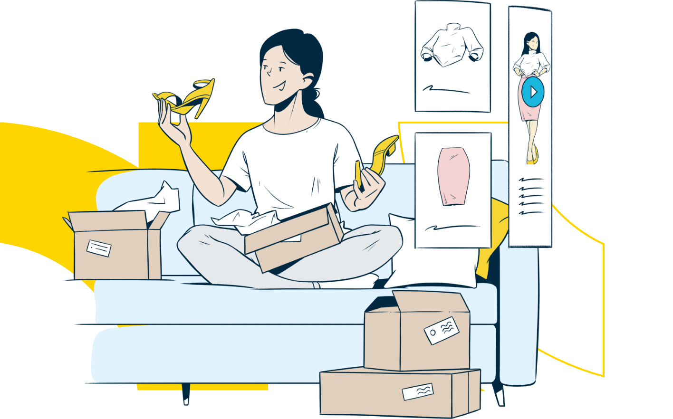
MERCHANDISING 2023 TREND REPORT
address inventory surplus.
Notes:
BRITTNI
On the opposite side of the equation is managing the supply chain challenges Jenna spoke about earlier. In other words, addressing inventory surplus.

Slide 13
Optimize for inventory surplus.
The Winning Strategy
Find the balance between optimizing for margin and reducing inventory carrying costs.
Integrate into S&OP
Provide inputs into the sales and operations planning process with the intention of improve forecasting accuracy and better aligning supply with demand.
Intentional Promotional Plan
Price to sell, but keep a pulse on cannibalization. There may be trade offs here.
Increased (+balanced) Visibility
Improve discoverability of surplus products.
Integrate into S&OP
Intentional Promotional Plan
Increased (+Balanced) Visibility
Notes:
I believe success here is marked by:
Better integration into the sales and operations planning process in order to improve forecasting accuracy and better align supply with demand.
A strong and intentional promotional plan that dwindles inventory levels while exciting customers about your new products and enticing cross purchases.
and increasing, but balancing visibility of these products during the discover phase. In other words, finding a balance between reducing inventory carrying costs and selling through the inventory while driving margins

Slide 14
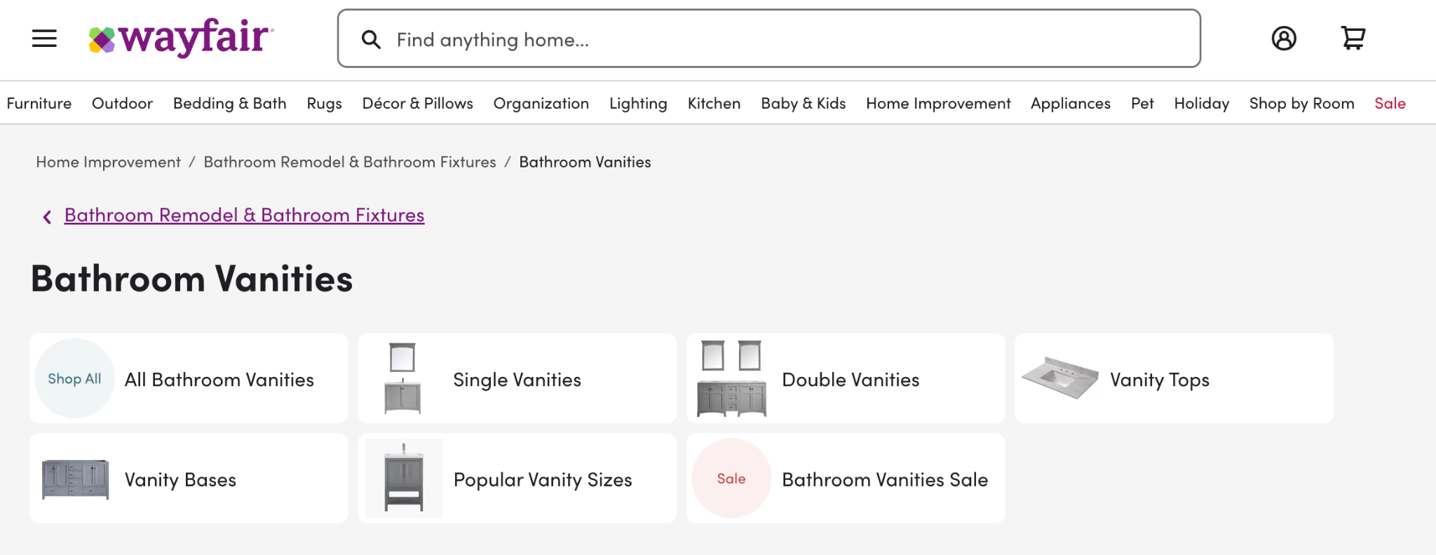
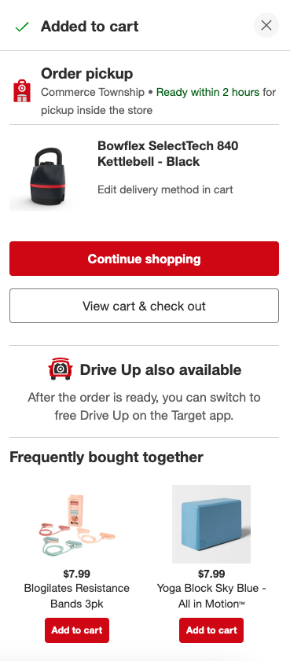
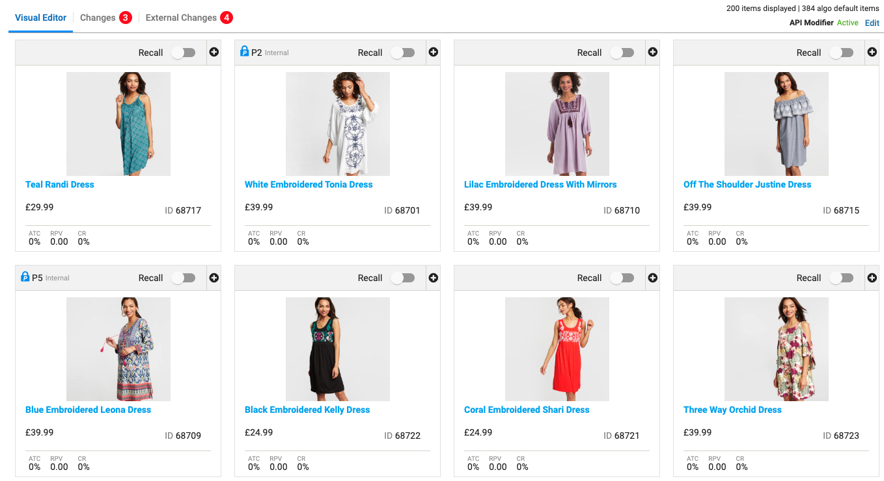

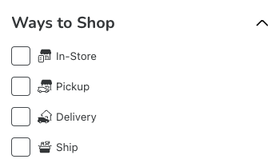
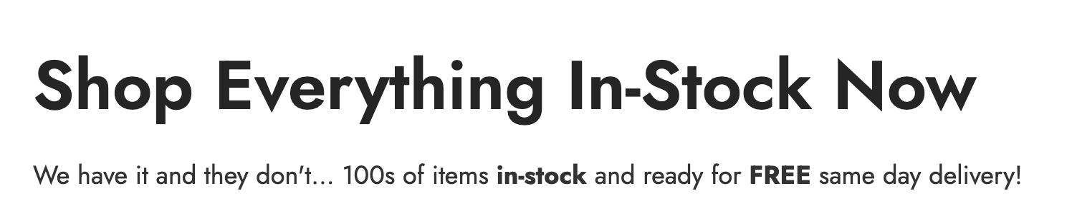

Increased (+balanced) Visibility.
OPTIMIZE YOUR SEARCH & CATEGORY LANDING PAGES.
DEMAND ATTENTION THROUGHOUT THE FUNNEL.
Test attribute boost & product lock within search and category grids to garner visibility.
But don’t stop there. Go Beyond the PLP. Visibility should be top of mind throughout the entire funnel. Utilize content and widgets to garner attention.
Excess inventory can also be intermingled within campaigns, too.
Target
Product Locks
Walmart
Boost & Bury Attributes
Kroger
Value City
Furniture
Gardner White
Availability may matter more to some customers than others. Give them ways to shop that meet their needs and yours.
Notes:
You can increase and balance visibility first by optimizing your search and category landing page grids. Test attribute boost & bury or locking specific products higher within the grid to garner visibility. There may be an opportunity to adjust your facet experience as well to better suit your customer. Availability may matter more to some than others and in the case of long inventory, you can fulfill their order right away, so utilize facets to increase visibility to this capability by giving your consumers ways to shop that meet their needs, but also help you achieve yours.
But don’t stop after optimizing your search and category landing pages. Go beyond the PLP. Visibility to these products should be top of mind throughout the entire funnel. Widgets and content can be used to garner attention. Take this walmart example in the video - they have intermingled new products, seasonal and deals on their homepage. Is there an opportunity to intermingle or showcase inventory where you’re long here too? On the right, target is leveraging the frequently bought together widget within checkout - consider doing this too, but leveraging inventory attributes to increase visibility to products where you’re long on inventory. Excess inventory can also be intermingled within campaigns where it makes sense, too. Take this gardner white example - shop everything in stock now. Customers may want convenience and you have the product available now and lots of it – lean into that where it makes sense of course to serve your customer’s needs more quickly and sell through your extras.

Slide 15
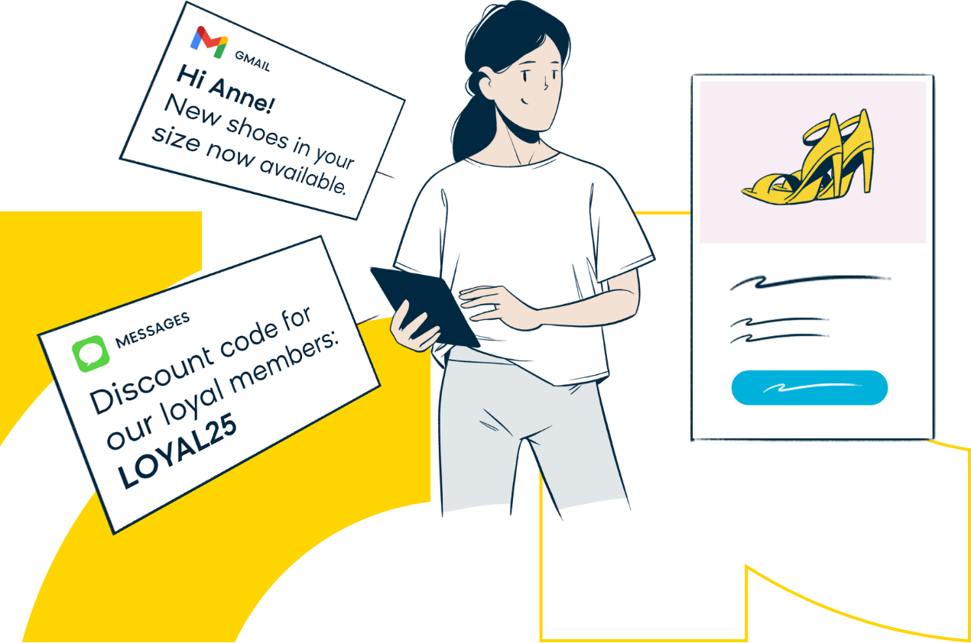
MERCHANDISING 2023 TREND REPORT
lean into segmentation.
Notes:
KYLE

Slide 16

Segmentation
The Business vs The Customer
Example Use Case
Business Assumptions & Priorities :
‘We need to deploy meaningful personalization across strategic segments to differentiate our store and drive incremental revenue for our business.’
What the Data Says:
Your customer segments are only as strong as two aspects: the strategy you create and the quality of your customer and event data. These two pieces are the foundation of your personalization strategy as you map customer to content and products.
The Winning Strategy
Notes:
KYLE
Segmentation:
Too often, we focus on the data and attributes we DO have versus the data and attributes we NEED.
Segmentation is only as strong as the data and as strong as the customer and event attributes you have, working just from the data you have is like fitting a problem to a solution. It's backwards.
Next slide > So, we advocate that you start with strategy. In a world of total possibilities, what segments are the most worth-while to activate against?
We recommend looking deeply into your best customers - the ones that spend more and buy more often than anyone else:
What do they look like? What do they have in common? Is there a threshold of purchases that "tips the scale" of a customer into a BEST customer?
This opens up inside out growth - how can you best nurture customers NEAR that threshold of say, 5 purchases, to get that next purchase over the line?
Summary: Start with strategy, back into your data, assess what attributes you might be missing, and address those gaps to ensure your segmentations are as strategic and worthwhile as possible,

Slide 17
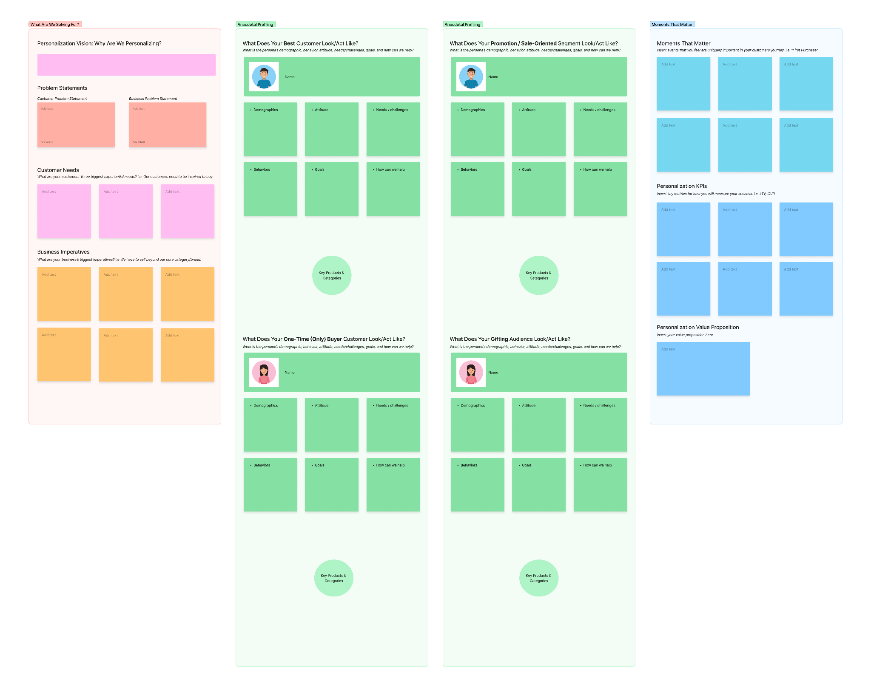
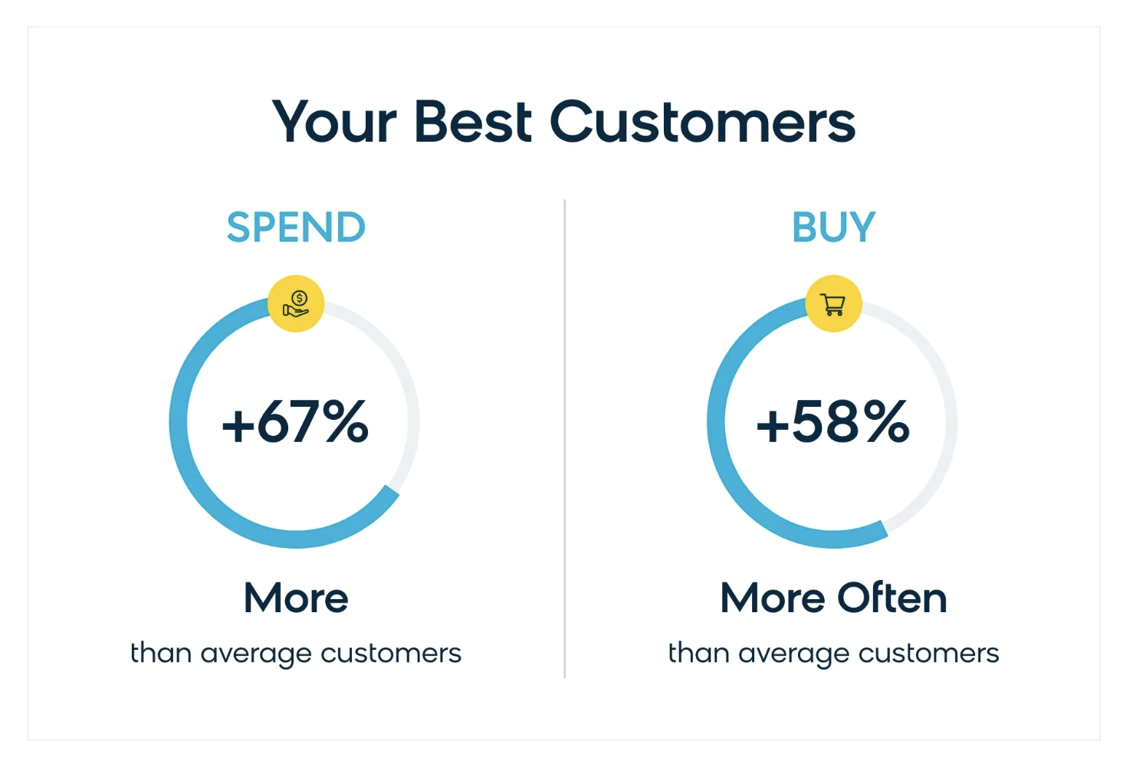
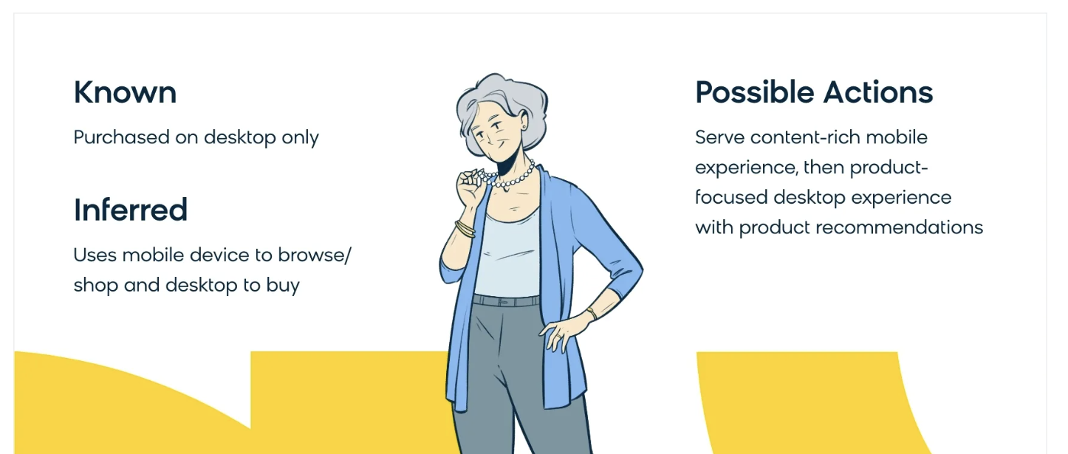
BR Segments: Lead With Strategy
Tip: Work with Bloomreach’s Experience Strategy Group to define segments
Notes:
KYLE

Slide 18

MERCHANDISING 2023 TREND REPORT
heightened focus on investing in product discovery experience.
search
Notes:
JENNA

Slide 19
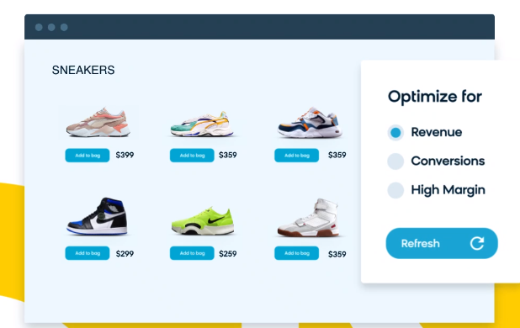
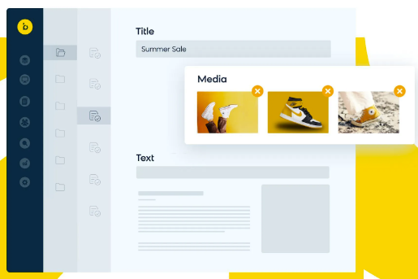
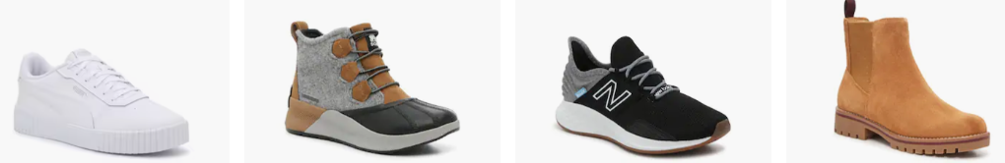

Building a strategy: micro conversions
Homepage
Primary KPIs
Engagement/click through
Bloomreach Search
Bloomreach Content
CLP / PLP
Category to Product Page
Product Views
PDP
Product Page to Add to List
Add to Cart
ATC
Bloomreach Recs
Trending Products
Add to List to Checkout
Purchase, increase basket size
Notes:
Think about the funnel and whole journey
The biggest favor you can do for your customer and yourselves - is to stop thinking about discoverability as a search or browse issue. Your customer does not care if search, content, UX, categories, recs, etc are all managed separately.
The product discovery journey is one experience, one journey, and it requires a delicate harmony of all of your experiential elements - working together to create a seamless, frictionless experience for your customers.
Work cross-functionally to ensure that content is embedded in product discovery - demystifying your assortment and aiding the buying journey.
Work cross-functionally to ensure product recommendations are paying off your search imperatives.
So, the biggest shift you can make this year to improve discoverability, is to take off the blinders and start working cross-functionally to deliver a whole experience, not just an experience that’s the sum of its individual parts.

Slide 20
MERCHANDISING 2023 TREND REPORT
consumer intent merchandising.
The Winning strategy
Business assumptions
& priorities
The Winning strategy
What the
data is telling you
Notes:
KYLE

Slide 21
Voice of Customer Merchandising
The Business vs The Customer
Example Use Case
Business Assumptions & Priorities :
‘We need to serve our consumer in the way that they want to shop. We need to identify the attributes that ‘lead’ the sale and ‘close’ the sale with our customers. This will help create a more differentiated, frictionless shopping experience.’
What the Data Says:
Search refinement data and searches from our top category pages reveal that an overwhelming amount of shoppers are looking for product type and size, while only a few are looking for specific brands.
The Winning Strategy
Notes:
KYLE

Slide 22
BR Data: Knowing where to look.
The Report | The Insights | Actions to Take
Insights -> Opportunities -> Improve Category Navigation High Next Search Traffic Category Pages Find Optimizations ->Site Searches from this Category Playbooks -> Find Optimizations -> Category View Customer Journey-> Next Query | Top trending new searches include product type and size predominantly | Audit category filters to ensure experience is easily shoppable by type and size. Consider “Boosting & Always Showing” type, size, and color facets Consider deploying visual pathways promoting best selling types and colors
 | Categories with highest search rate include product type, size
 | High exit rate categories demonstrate products with high association scores not in top positions | Dive into Playbooks and Edit the Grid from the “Boost Products” section of the dashboard Locate 2-3 products with the highest association score and boost those products
Insights -> Opportunities -> Improve Site Search Queries with Highest Increase in Volume Queries With Highest Refinement Playbooks -> Find Optimizations -> Query | Next query with highest volume is ‘jacket’ | Consider promoting the jacket category using pathways across similar categories (i.e. coats, umbrellas, jumpers, etc)
 | A high volume of sales of spring products are selling from the mens, womens core categories | Consider boosting high volume spring products in core categories to drive sell through
Notes:
KYLE

Slide 23
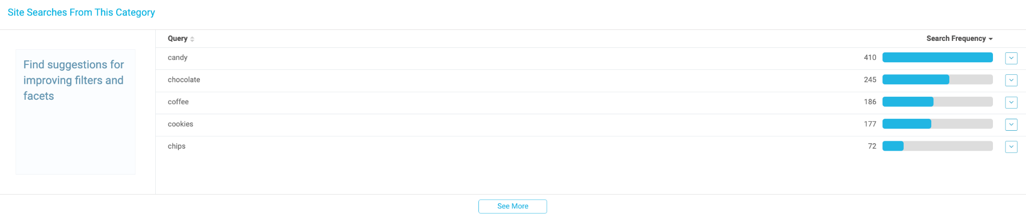
BR Data: Knowing where to look.
Do your filters & facets or visual pathways reflect the kinds of products that customers are searching for upon arriving to this category?
Top Tip: Listen to your shoppers. they’re telling you how they want to shop.
Notes:
KYLE

Slide 24

Q&A

Slide 25

Keep the conversation going…
join the Bloomreach Slack Community!
Stay up-to-date on all things monthly Best Practices and access resources related to our session topics by adding yourself to the #discovery-best-practices channel
Network and share ideas with fellow Bloomreach customers
Hear the latest news from Bloomreach and stay informed about industry trends
→ Link to join

Slide 26



Let’s keep the conversation going!
Join the Digital Merchandising Community on Linkedin
Invite a friend..OR two to join the community and the events
If you are interested in being apart of a future panel, we would love to have you join one!

